Slide 1
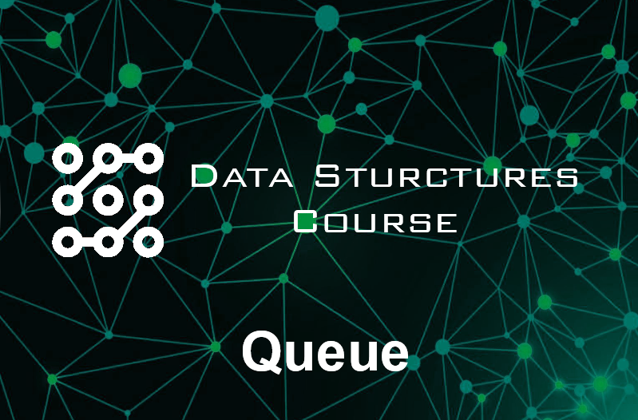

Slide 2
Agenda
Definition of Queue
Queue ADT operations
Types of Queue
Implementation
Queue Applications
Simple project on Queue

Slide 3
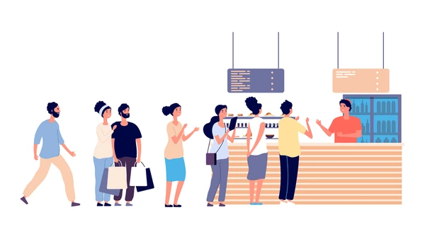
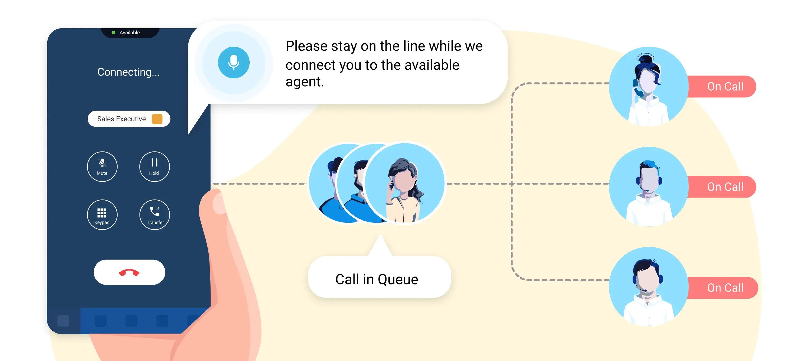
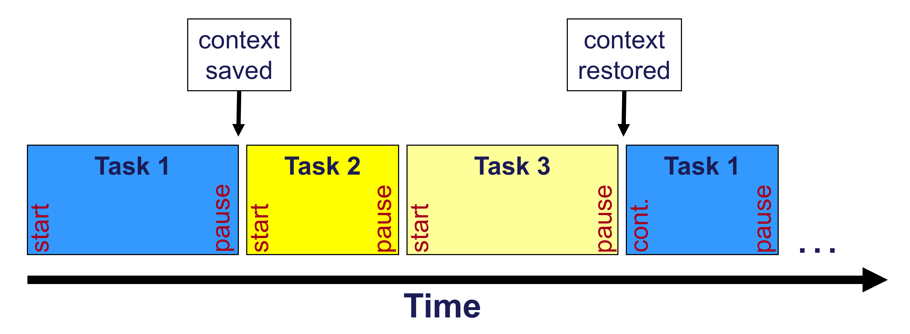
Definition of Queue
A Queue is a logical linear data structure that follows the FIFO (First In, First Out) principle. This means that elements are added at the rear and removed from the front, just like a real-world queue (e.g., people standing in line).
Real-world examples :
People waiting in line at a restaurant.
Call center queue
Task scheduling in operating systems

Slide 4
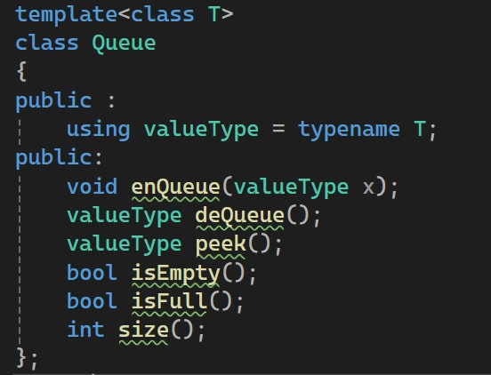
Queue ADT operations
enQueue(val) Inserts element x at the rear of the queue.
deQueue() Removes and returns the front element.
peek() Return the front element
isEmpty() Checks if queue empty or not
isFull() Checks if queue full or not
size() Return number of elements on the queue

Slide 5
Types of Queue
Priority Queue
Circular Queue
Simple Queue
Deque

Slide 6
Types of Queue
Priority Queue
Circular Queue
Deque
Simple Queue

Slide 7
Simple Queue
A simple queue (also called a FIFO queue) is a basic data structure where elements are inserted at the rear and removed from the front, following the First In, First Out (FIFO) principle

Slide 8
Simple Queue
Peek() -> Null
isEmpty() -> true
isFull() -> false
size() -> 0
Front
Rear

Slide 9
Simple Queue
enQueue(10)
Peek() -> 10
isEmpty() -> false
isFull() -> false
size() -> 1
Front
10
Rear

Slide 10
Simple Queue
enQueue(20)
Peek() -> 10
isEmpty() -> false
isFull() -> false
size() -> 2
Front
10
20
Rear

Slide 11
Simple Queue
enQueue(3)
Peek() -> 10
isEmpty() -> false
isFull() -> false
size() -> 3
Front
10
20
3
Rear

Slide 12
Simple Queue
deQueue()
Peek() -> 20
isEmpty() -> false
isFull() -> false
size() -> 2
Front
20
3
Rear

Slide 13
Hands-On
Implement Generic and dynamic simple queue

Slide 14
Helps
enQueue(x)
Ensure that Queue isn’t Full
Moving rear pointer to the next element and insert the Element x
Increase size by one
deQueue()
Check that Queue isn’t empty
Store the front element in a temporary variable
Remove the front element then move front pointer
Decrease size by one
Return the temporary variable
Peek()
Return the front element
isEmpty()
Check if size greater than 0
IsFull()
Check if front equals capacity - 1
size()
Return size variable

Slide 15
Implementation of Simple Queue (link)

Slide 16
Circular Queue
Why Circular Queue ?
Efficient Memory Utilization
A linear queue wastes space when elements are dequeued because the front moves forward, leaving unused memory at the beginning.
A circular queue reuses empty spaces, ensuring better memory management.
Circular Queue
Front
Simple Queue
Front
10
10
isFull() -> false
isFull() -> true
Rear
Rear

Slide 17
Circular Queue
After some Operations
Front
Peek() -> 10
isEmpty() -> false
isFull() -> false
size() -> 1
10
Rear

Slide 18
Circular Queue
enQueue(15)
Peek() -> 10
isEmpty() -> false
isFull() -> false
size() -> 2
Front
10
15
Rear

Slide 19
Circular Queue
enQueue(25)
Peek() -> 10
isEmpty() -> false
isFull() -> false
size() -> 3
Front
15
10
25
Rear

Slide 20
Circular Queue
deQueue()
Peek() -> 15
isEmpty() -> false
isFull() -> false
size() -> 2
Front
15
25
Rear

Slide 21
Hands-On
Enhance the previous Simple Queue Model to Circular Queue Model

Slide 22
Helps
enQueue(x)
Ensure that Queue isn’t Full
Moving rear pointer to the next element (rear + 1) mod capacity and insert the Element x
Increase size by one
deQueue()
Check that Queue isn’t empty
Store the front element in a temporary variable
Remove the front element then move front pointer (front + 1) mod capacity
Decrease size by one
Return the temporary variable
IsFull()
If size equals capacity

Slide 23
Implementation of Circular Queue (link)

Slide 24
Deque
Allows us to insert and delete from both sides which makes it more flexible and efficient
enQueueFront(x)
enQueueBack(x)
deQueueFront()
deQueueBack()
Access on both back and front
front()
back()
Why Deque?

Slide 25
Deque
After some Operations
Front
front() -> 25
back() -> 25
isEmpty() -> false
isFull() -> false
size() -> 1
25
Rear

Slide 26
Deque
enQueueFront(15)
front() -> 15
back() -> 25
isEmpty() -> false
isFull() -> false
size() -> 2
Front
25
15
Rear

Slide 27
Deque
enQueueBack(30)
front() -> 15
back() -> 30
isEmpty() -> false
isFull() -> false
size() -> 3
Front
15
25
30
Rear

Slide 28
Deque
enQueueBack(40)
front() -> 15
back() -> 40
isEmpty() -> false
isFull() -> false
size() -> 4
Front
30
15
25
40
Rear

Slide 29
Deque
deQueueBack()
front() -> 15
back() -> 30
isEmpty() -> false
isFull() -> false
size() -> 3
Front
30
15
25
Rear

Slide 30
Deque
deQueueFront()
front() -> 25
back() -> 30
isEmpty() -> false
isFull() -> false
size() -> 2
Front
30
25
Rear

Slide 31
Hands-On
Try to implement deque

Slide 32
Helps
enQueueFront(x)
Ensure that Queue isn’t Full
Moving front pointer to the next element (front - 1) mod capacity and insert the Element x
Increase size by one
enQueueBack(x)
Ensure that Queue isn’t Full
Moving rear pointer to the next element (rear + 1) mod capacity and insert the Element x
Increase size by one
deQueueFront()
Check that Queue isn’t empty
Store the front element in a temporary variable
Remove the front element then move front pointer (front + 1) mod capacity
Decrease size by one
Return the temporary variable
deQueueBack()
Check that Queue isn’t empty
Store the rear element in a temporary variable
Remove the rear element then move rear pointer (rear - 1) mod capacity
Decrease size by one
Return the temporary variable
IsFull()
If size equals capacity

Slide 33
Implementation of Deque(link)

Slide 34
Priority Queue
Why Priority Queue?
A priority queue is a special type of queue where each element is assigned a priority. Unlike a normal queue (FIFO), in a priority queue, elements are dequeued based on priority, not just the order in which they were added.
implementation in heapify video

Slide 35
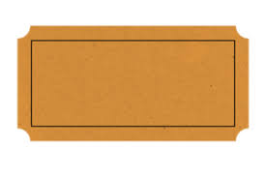
Applications of Queue
Doctor’s Office

Slide 36

No Patient in Doctor’s office

Slide 37
Patient bought ticket with number equal 1
1

Slide 38
1
Patient No.1 Entered

Slide 39
1
Patient bought ticket with number equal 2
2

Slide 40
2
Patient NO.1 finished
NO.2 entered

Slide 41
Let’s solve

Slide 42
Simple
Queue
Project
Restaurant Order Management System
Insert customer order
Serve order
Display current order
Display pending orders and Ready orders
Handle states of empty queue

Slide 43

Thanks!

